Slide 1
Patient Monitoring System
Under the guidance of
SURESH VARMA SIR
M. Siri Mounica
P. Raveena
Md. Heena
P. Prudhvi Raghav

Slide 2
Objective
Health monitoring is a major issue.
IoT devices monitor the health of the patient over internet.
Advantage of smart devices for Health Experts.

Slide 3
Introduction
IoT based Health Monitoring System.
Pulse rate and body temperature readings are recorded.
ThingSpeak is the cloud-service used to view this data over internet.
Sends an Email/SMS whenever they are beyond the critical values.

Slide 4
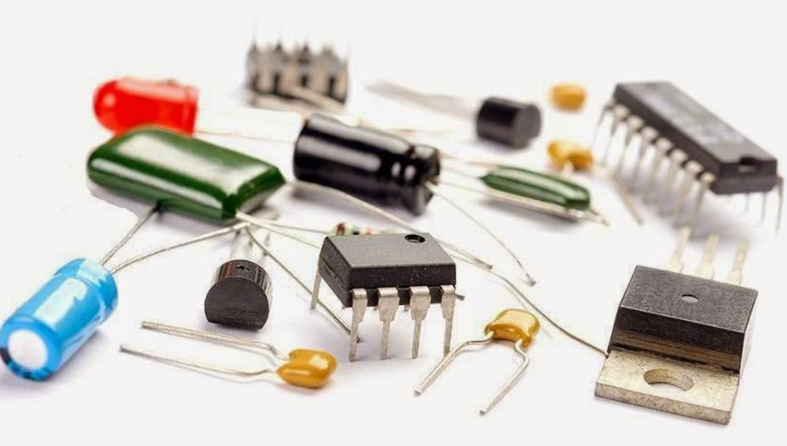
Components required
Arduino Uno
ESPN8266
LM35 Temperature sensor
Pulse rate sensor
Push button
10K Resistor
Male – Female wires
Breadboard

Slide 5
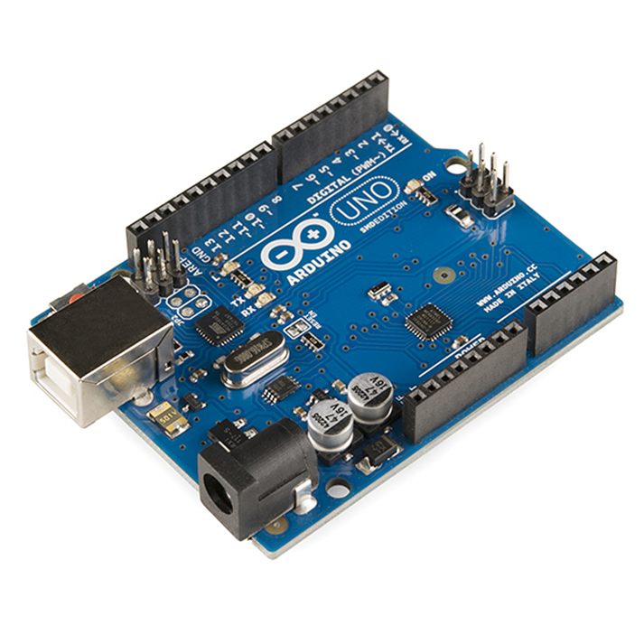
Arduino UNO
Open-source microcontroller based on microchip ATmega328P.
Consists of 14 digital pins and 6 analog pins.
Programmable with Arduino IDE.

Slide 6
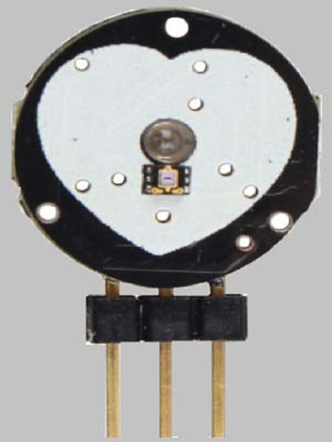
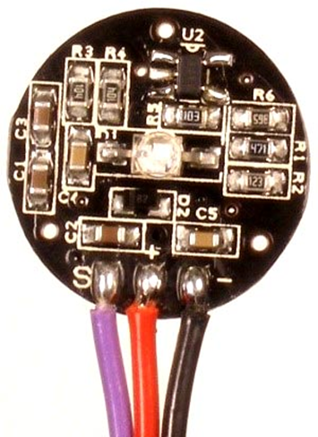
Pulse rate sensor
The sensor clips onto a fingertip or earlobe
and plugs right into Arduino.

Slide 7
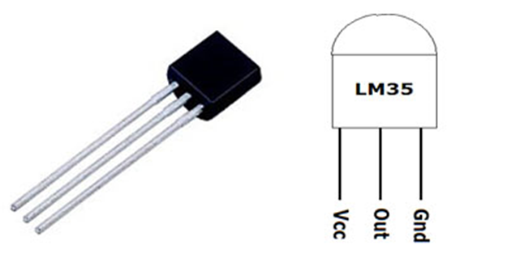
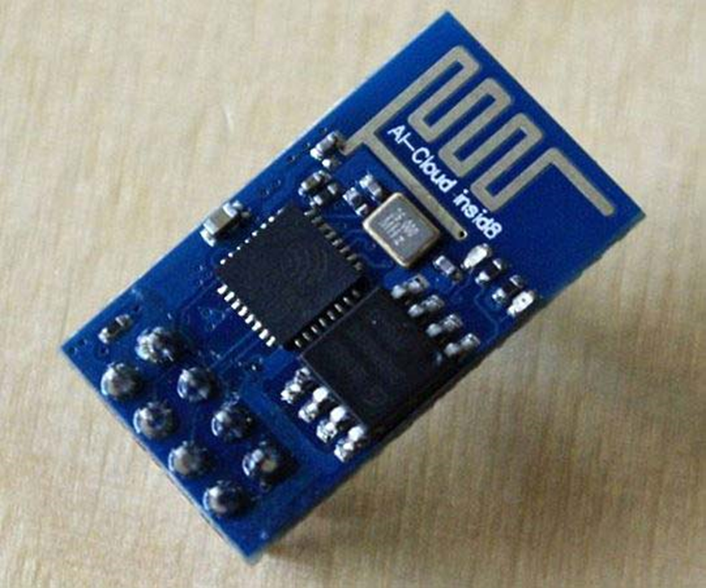
LM35 Temperature Sensor
ESESP8266
Micro controller, to perform Wi-Fi related activities.
Two ways to work with ESP8266 module.
One way is by AT commands
Another way is by Arduino IDE.
Sensor output is proportional to Temperature.
Output voltage varies by 10mV in response to every rise or fall in temperature.

Slide 8
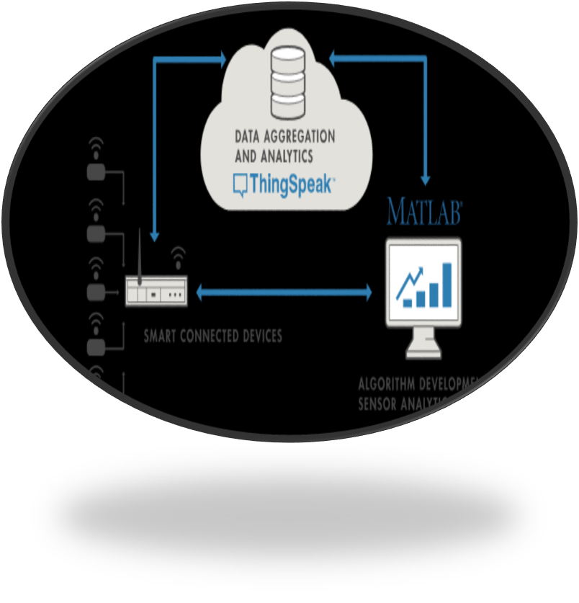
ThingSpeak
Collects the data from sensor.
Analyze and visualize the data.
Acts by triggering the reactions.

Slide 9


